Slide 1
healthy nutrition & sustainable development goals via implementation of WHO best buys for NCDs
João Breda
Head, WHO European Office for Prevention and Control of Noncommunicable Diseases
Notes:
Commissioner Andriukaitis, honourable ministers, distinguished guests, ladies and gentleman, it is my very great pleasure to be with you today and to be invited to speak on a matter of such importance to Europe.

Slide 2
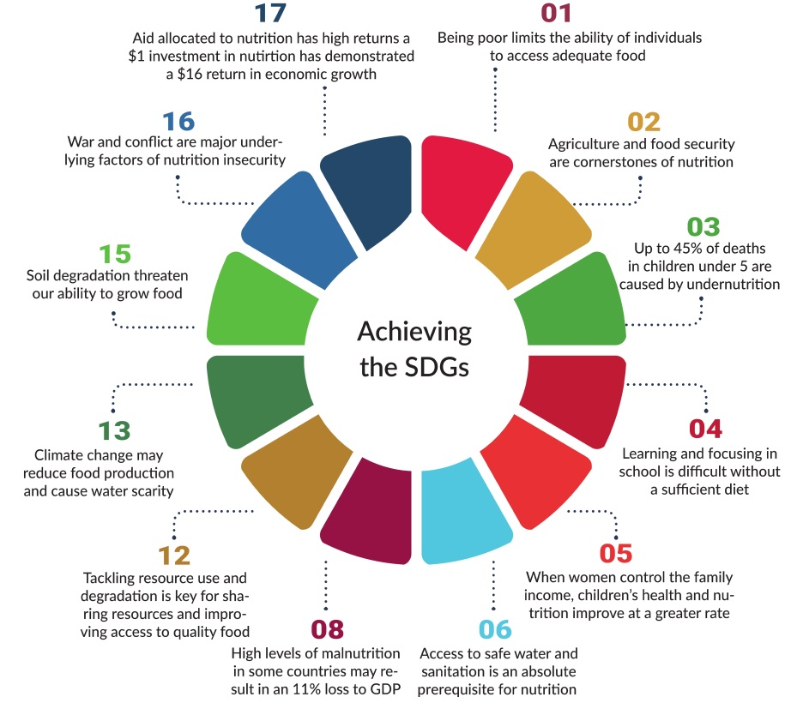
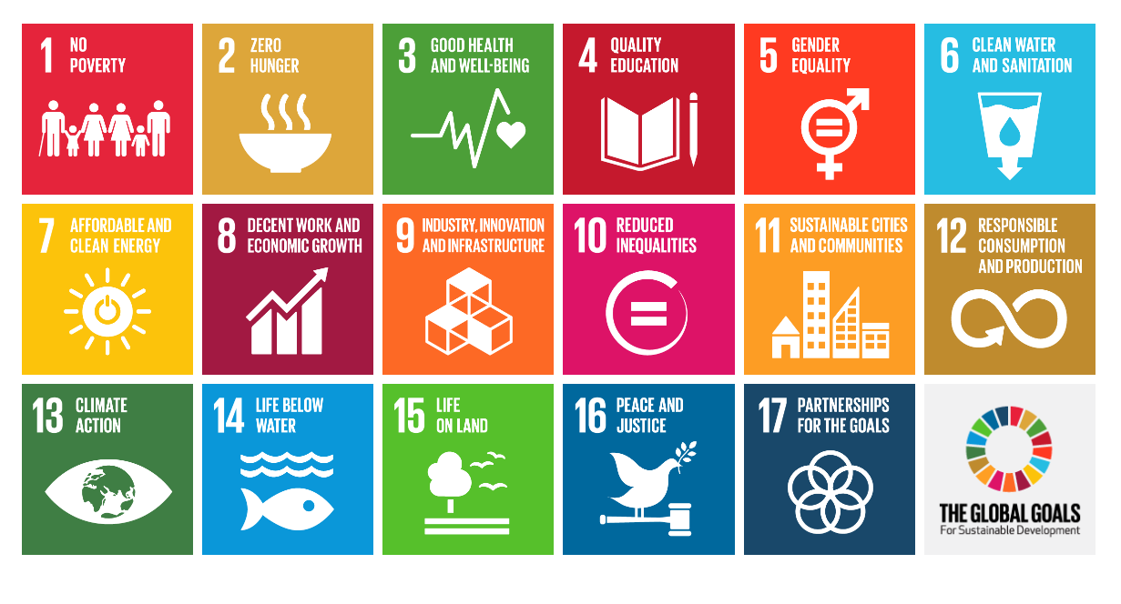
Nutrition & PA vital for the success of the SDGs

Slide 3
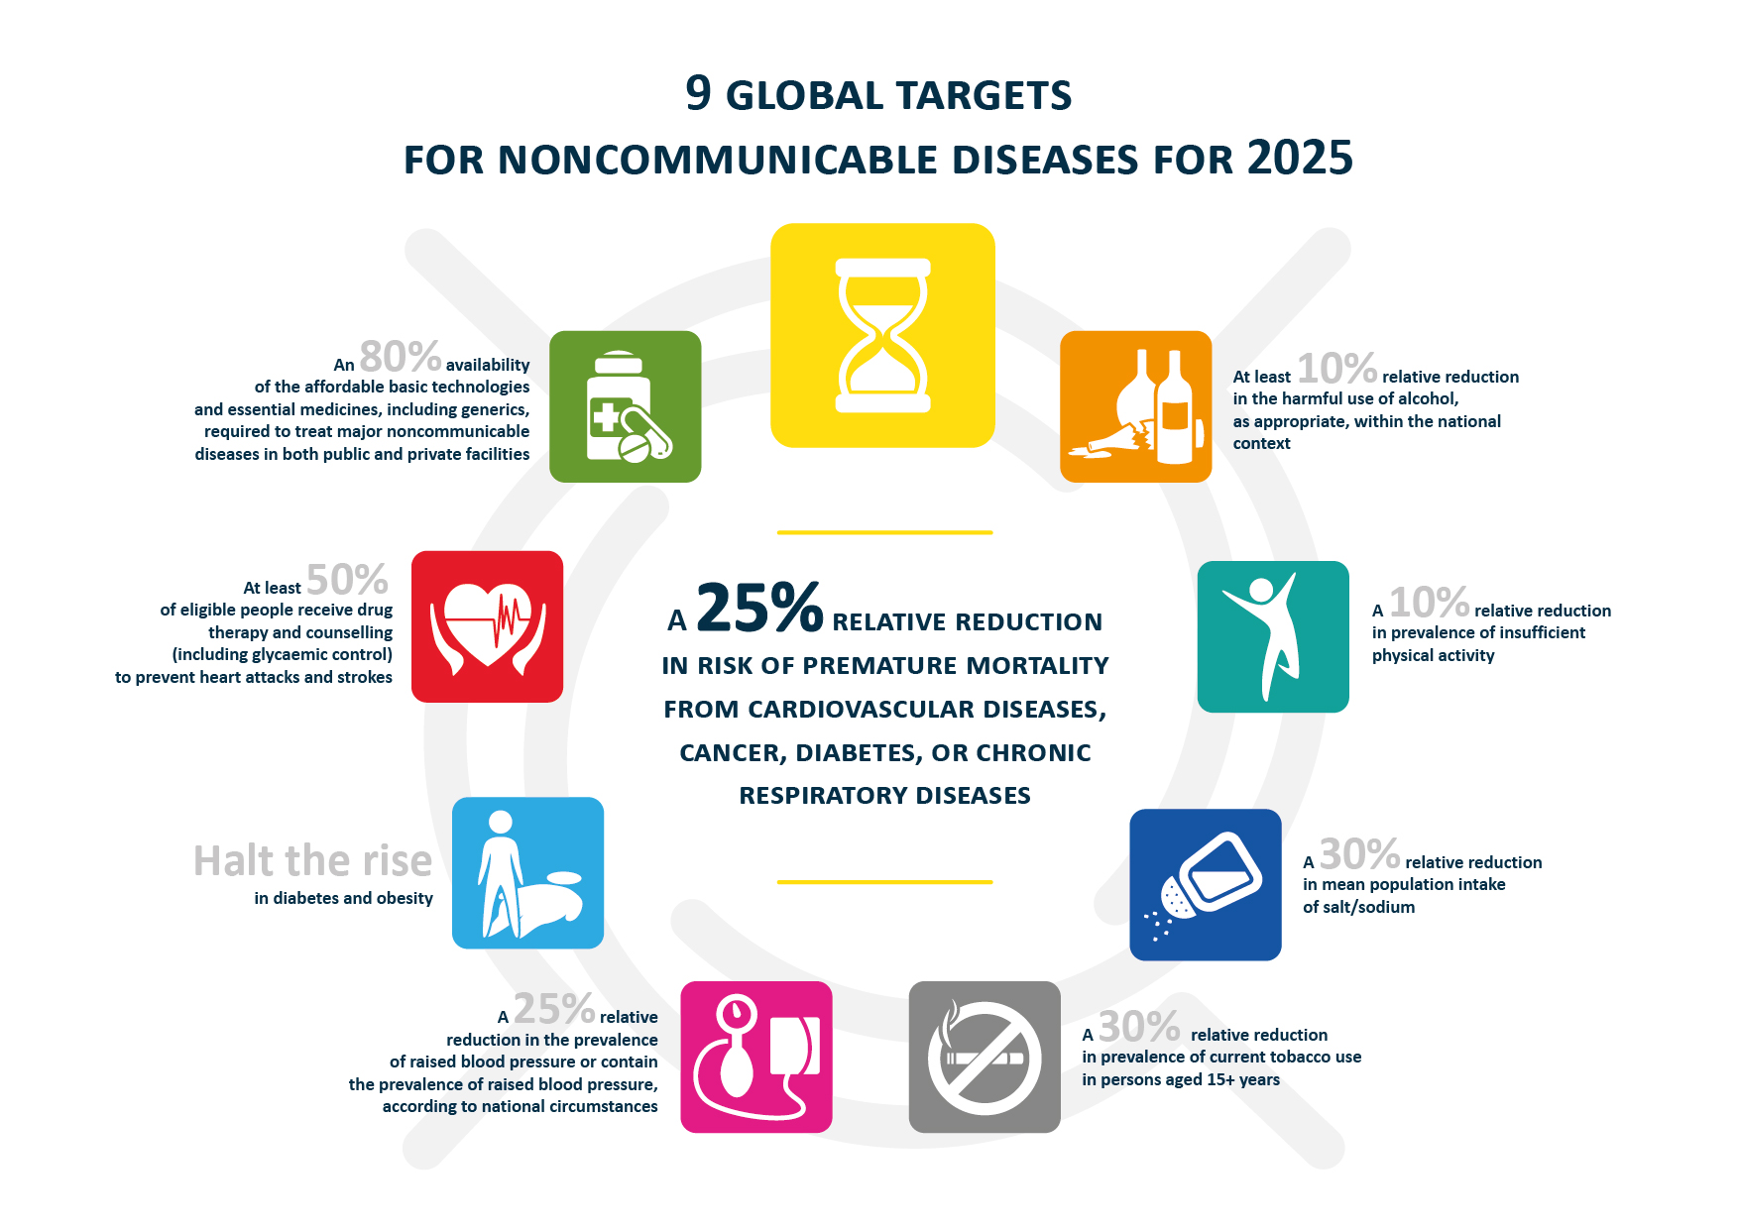

Slide 4

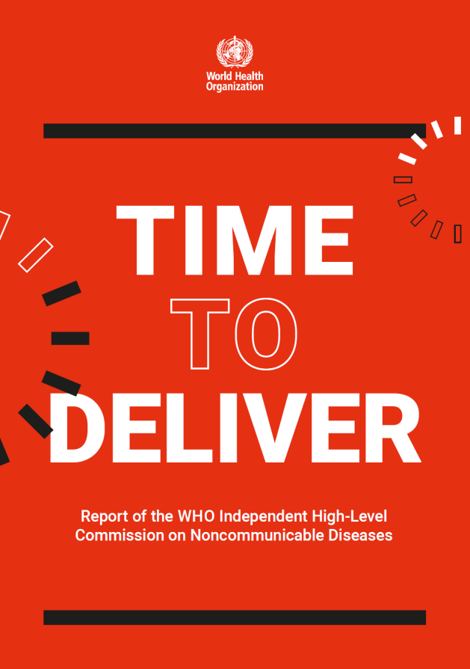
Notes:
The recent UN HLM on NCDs outcome statement and the report of the independent Commission on NCDs are very clear in highlighting the urgency of taking action and the pressure to ensure clear results in a reasonable period of time.
They also underline the need for comprehensive action, the importance of engagement across sectors and different dimensions contributing to health and well-being
It reminds me an orchestra where all playing will bring the desire outcome – remember the complexity of the interactions! We also need a great conductor… that could be the MoH or any other leader….

Slide 5
Global Monitoring Framework Scoreboard for Europe Much remains to be done in next decade
1
2
3
4
5
6
7
8
9
http://ncdoffice.link/Monitoring http://ncdoffice.link/CountryProfiles

Slide 6


Create healthy food and drink environments
Promote the gains of a healthy diet throughout life, especially for the most vulnerable
Reinforce health systems to promote healthy diets
Support surveillance, monitoring, evaluation and research
Strengthen governance, alliances and networks to ensure a health-in-all-policies approach
Notes:
The Action Plan was adopted in September 2014 at the WHO RC for Europe. It calls for countries to act, using a whole-of-government, health-in-all-policies approach. Its priority actions will contribute to improving food-system governance and the overall quality of the European population's diet and nutritional status. The objectives are listed here– there is an emphasis on healthy environments, taking a lifecourse approach, protecting the vulnerable, reinforcing health systems, surveillance/monitoring/evaluation/research and adopting a health-in-all-policies approach.

Slide 7

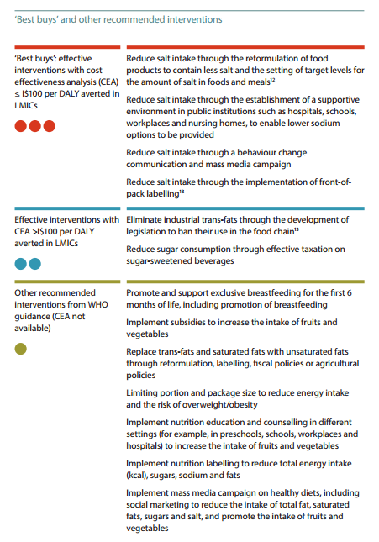


Slide 8
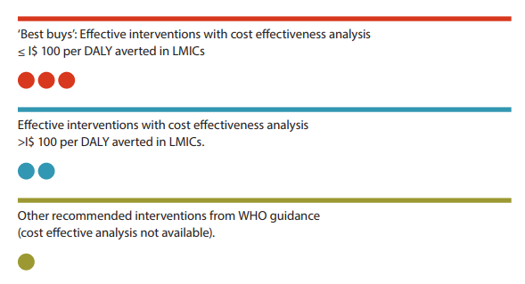
Types of recommended interventions
Best buys: most cost-effective and feasible for implementation. Cost-effectiveness ratio of ≤100 I$1 per DALY (WHO Choice analysis)
Other effective interventions: WHO Choice analysis produced a cost effectiveness of above the threshold of I$ ≤100 per DALY averted.
Other recommended interventions: shown to be effective (no cost-effectiveness analysis).
Notes:
Best buys where a WHO Choice analysis found an average cost-effectiveness ratio of ≤100 I$1 per DALY averted in low- and lower middle-income countries.

Slide 9


NAO: planned activities for 2019 - contribution to GPW13 and SDG
Reduce salt intake through:
Product reformulation
Provision of lower salt options in public institutions
Behavior change communication and mass media campaigns
Front-of-pack labeling
Eliminate industrial trans fat through legislation to ban their use in the food chain
Reduce sugar consumption taxation & reformulation SSBs - CO

Slide 10



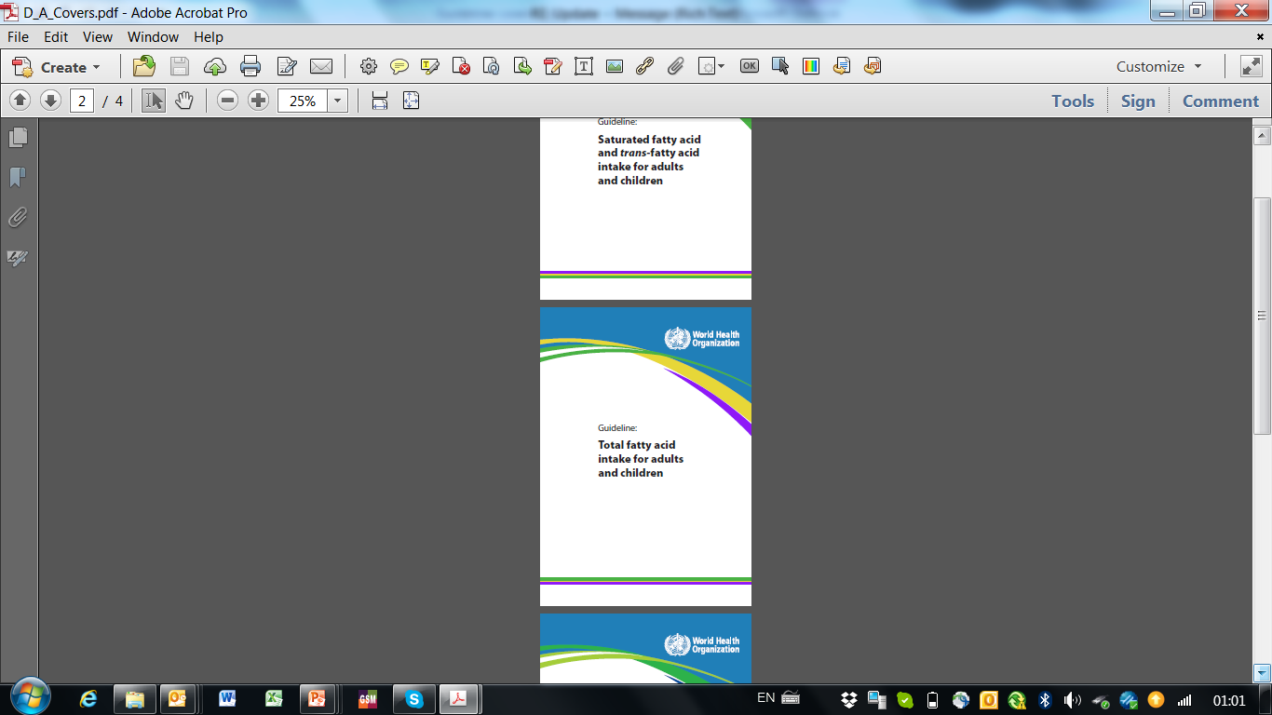
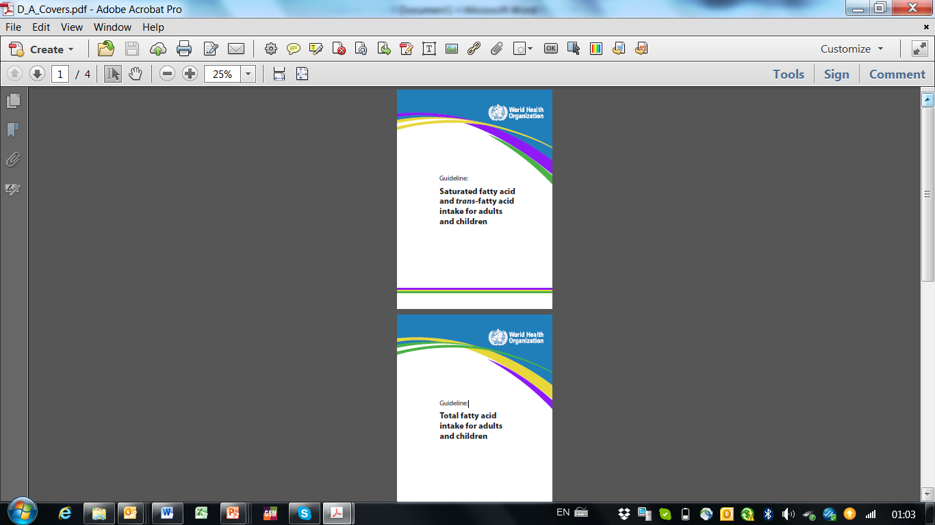
Achieving dietary goals

Slide 11
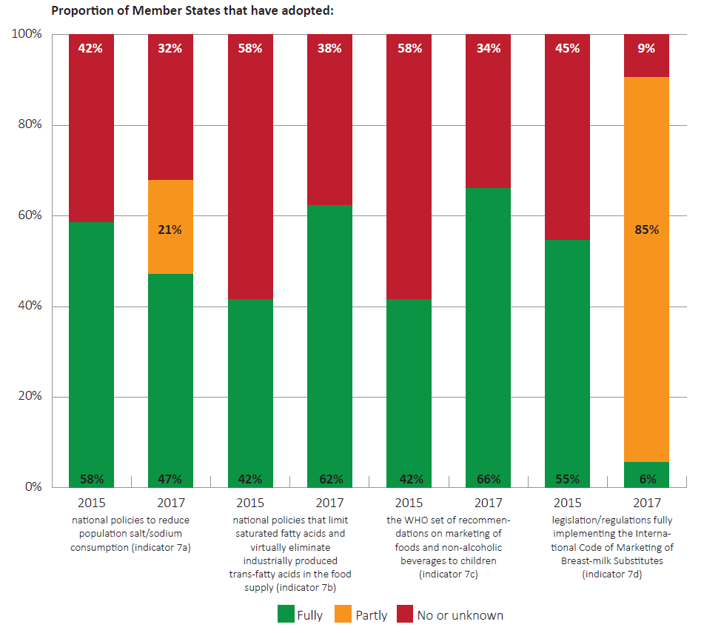
Unfinished business – food policies
Source: Various
Unpublished: WHO/Europe 2018
Notes:
WHO has a number of recommended policies to improve the food supply, especially related to reducing salt consumption, eliminating trans-fats, protecting children from marketing of unhealthy products and promoting breastfeeding. This slide shows that while we are making progress in some areas, there are still many areas for improvement.

Slide 12

Aligned with priority policies contained in regional policy frameworks
Priority policy options
Strong controls on marketing, incl. but not limited to TV advertising
Price policies applied to foods and drinks
Consumer-friendly front of pack labelling
Reformulation, calorie reduction, smaller portions
Notes:
12

Slide 13

Develop a comprehensive salt reformulation strategy

Slide 14
Salt – Blood Pressure – CVD Model
SALT
BP
CVD

Slide 15
Policy goal: a gradual and sustained reduction in salt intake
Salt reduction
Food industry
Health professionals
NGOs
Government
Mass Media

Slide 16
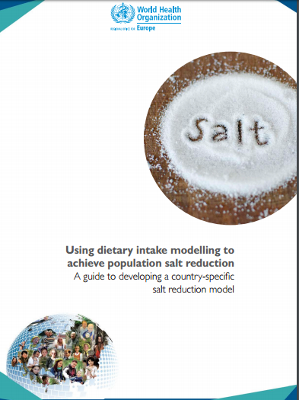
Tool to support countries model required reductions in salt content in foods
To inform the development of salt models in selected European countries by helping countries:
Identify sources of salt in the diet
Prioritise foods for target setting
Negotiate with stakeholders
Monitor progress
Notes:
In addition, WHO thisThe intention of the Action Plan is to significantly reduce the burden of preventable diet-related NCDs, overweight, obesity and all other forms of malnutrition still prevalent in the WHO European Region. It calls for action through a whole-government, health-in-all-policies approach.
This 5 priority areas will contribute to improving food system governance and the overall quality of the European population’s diet and nutritional status.

Slide 17
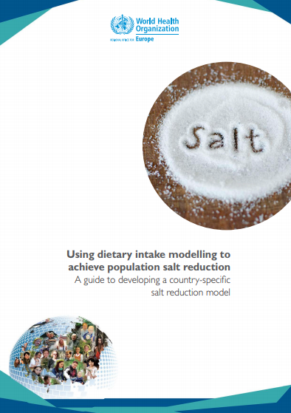
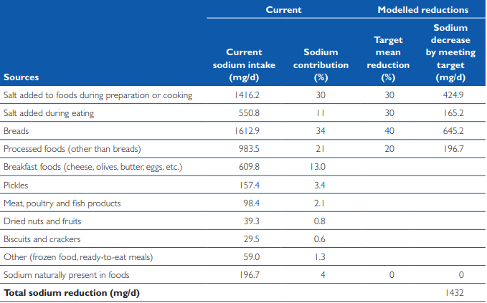
Turkey model to achieve 30% reduction in salt intake

Slide 18
Monitoring salt reduction
Food level
Compliance monitoring
Monitoring food supply
Population level
Food consumption
surveys
Urinary excretion studies

Slide 19

Develop an interpretative front-of-pack labelling system

Slide 20
Why act?
Over one-quarter of all foods purchased by households across Europe are highly processed
Shelf space devoted to processed foods high in saturated (and trans) fatty acids, sugar and/or salt often exceeds that for healthier foods
Marketing claims and point-of-purchase promotions highly prevalent
Nutrition labelling provides an important tool to support consumers make healthier food choices
Labelling can also drive food product reformulation
Notes:
Main point: not just agriculture

Slide 21
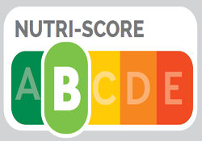

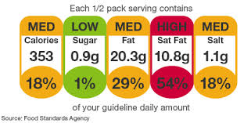
In Europe there are four main types of interpretive front of pack labels:
Endorsement logos
Summary indicator systems
Nutrient-specific warning labels
Nutrient-specific interpretive label

Slide 22

WHO report on interpretive labelling in Europe
Health Evidence Network report guided by the question
“What is the evidence on the policy specifications, development processes and effectiveness of existing front-of-pack food labelling policies in the WHO European Region?”

Slide 23
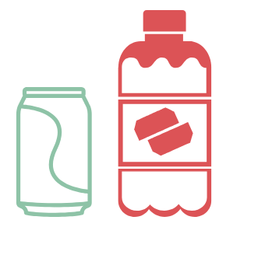
Introduce a tax on sugar sweetened beverages and consider its implementation for foods high in fat, salt and sugar.

Slide 24
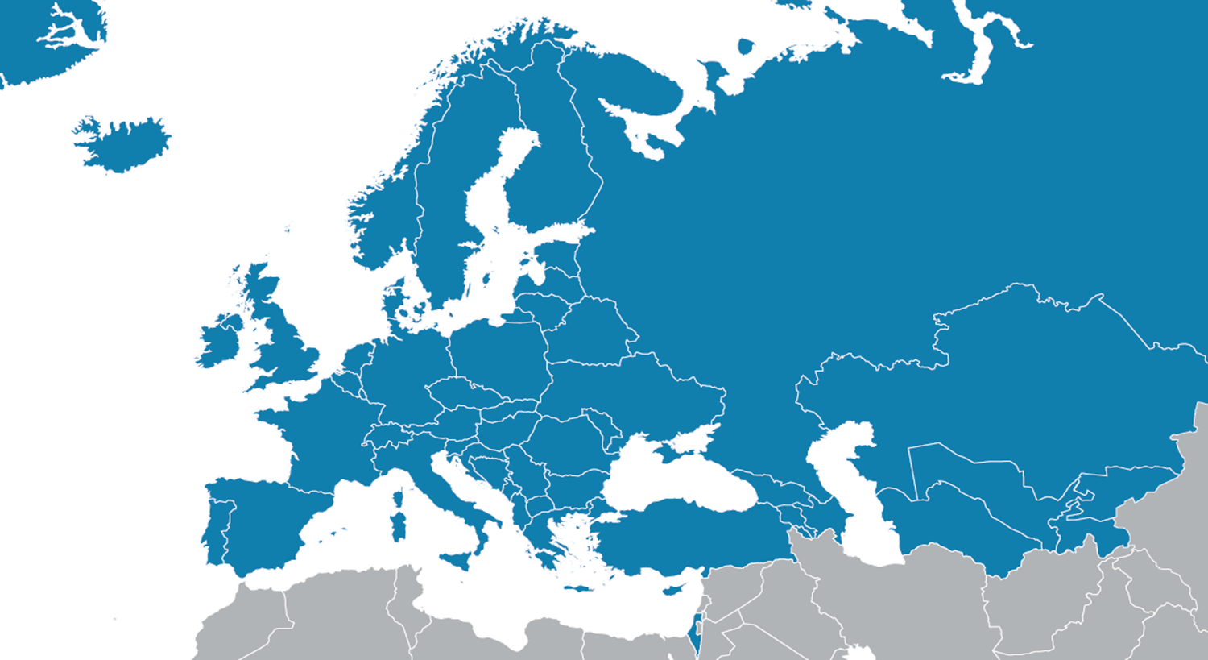
Countries reporting health-related taxes in Europe

Slide 25
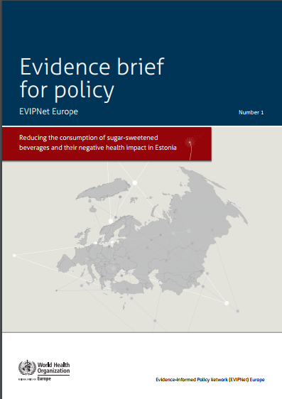
Estonia – building the case for action
With WHO support, Estonia produced an evidence brief for policies to reduce the consumption of SSBs:
Regulation of food marketing
Clear labelling
Tighter school food restrictions
Taxation
Concluded that a tax of 10-15% would reduce consumption
Used to inform national policy debates, and a tax was announced but not implemented

Slide 26
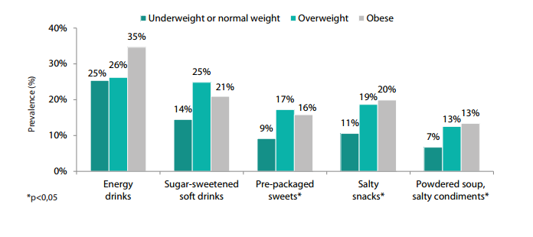
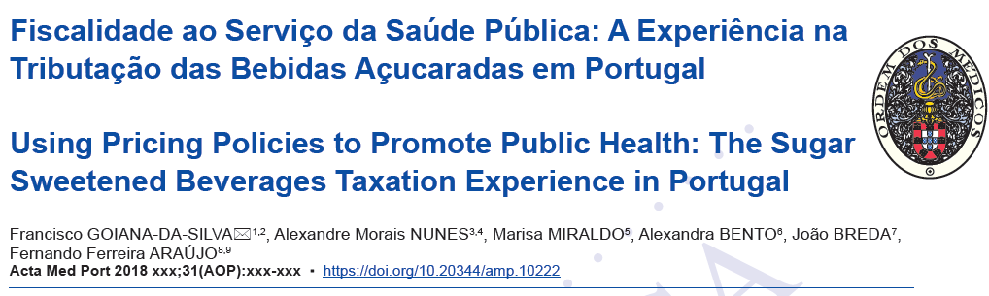
Evaluating impact of taxes: Hungary & Portugal
Proportion of people who changed consumption, according to weight status
50% reduction in consumption of products with more than 8 g sugar per 100 ml
Sources: WHO Europe, Assessment of the impact of a public health product tax: Hungary & Acta Medica Portuguesa 2018

Slide 27

WHO has helped countries in the region advance their domestic policy agenda on TFAs by supporting them in collecting critical data
Notes:
Staggering progress towards the achievement of WHO Global targets
Progress towards the achievement of some selected global targets is uneven. For some indicators a vast majority of countries is off-tack particularly when it comes to breastfeeding, obesity, anemia and physical activity.

Slide 28
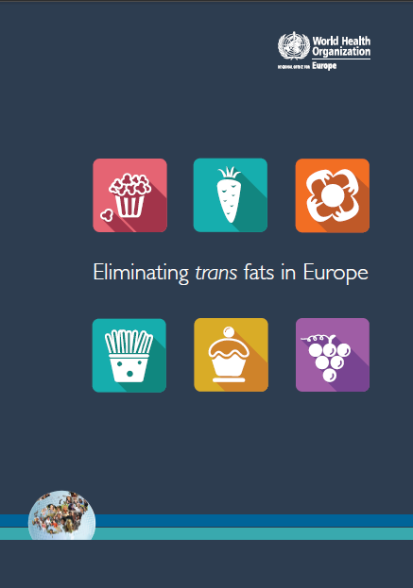
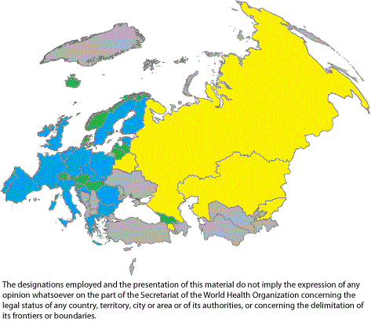
Trans fatty acids – mandatory legislation
Countries with a current (red) or soon-to-be implemented (yellow) legislative ban on trans-fatty acids in food products

Slide 29

Introduce regulatory restrictions on marketing of food that children are exposed to, using the WHO nutrient profile model

Slide 30


DIGITAL
MARKETING

Slide 31
Challenges
Age of the child
“Targeted” to children vs.
exposure
Nutrient profiling
Addressing all forms of marketing
Notes:
Packaging
Branding

Slide 32

Promote and support exclusive breastfeeding for the first 6 months of life

Slide 33
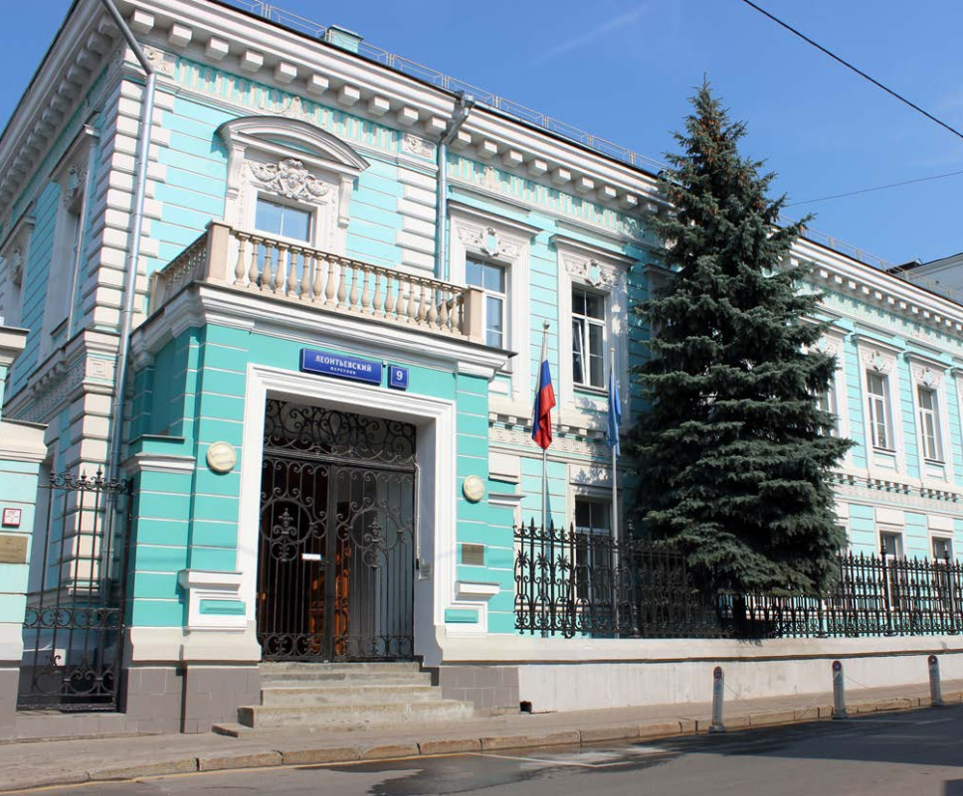
Thank you!
WHO European Office for the Prevention and Control of NCDs
Address
9 Leontyevskiy Pereulok (Леонтьевский пер. 9)
125009 Moscow, Russian Federation
Email
NCDoffice@who.int
Weblink
http://www.euro.who.int/en/health-topics/noncommunicable-diseases/pages/who-european-office-for-the-prevention-and-control-of-noncommunicable-diseases-ncd-office

